Slide 1


Nathen Harvey
Community Director at Chef
Co-host of the Food Fight Show
Co-organizer of DevOpsDC meetup
Occasional farmer – http://bit.ly/farmer-nathen
Love Eggs – http://eggs.chef.io
@nathenharvey
nharvey@chef.io

Slide 2
My SysAdmin Journey
ssh
Store notes in ~/server.txt
Move notes to the wiki
Write some scripts (setup.sh, fixit.sh, etc.)
Golden images and snapshots
Remote execution via ssh
Policy-driven configuration management

Slide 3
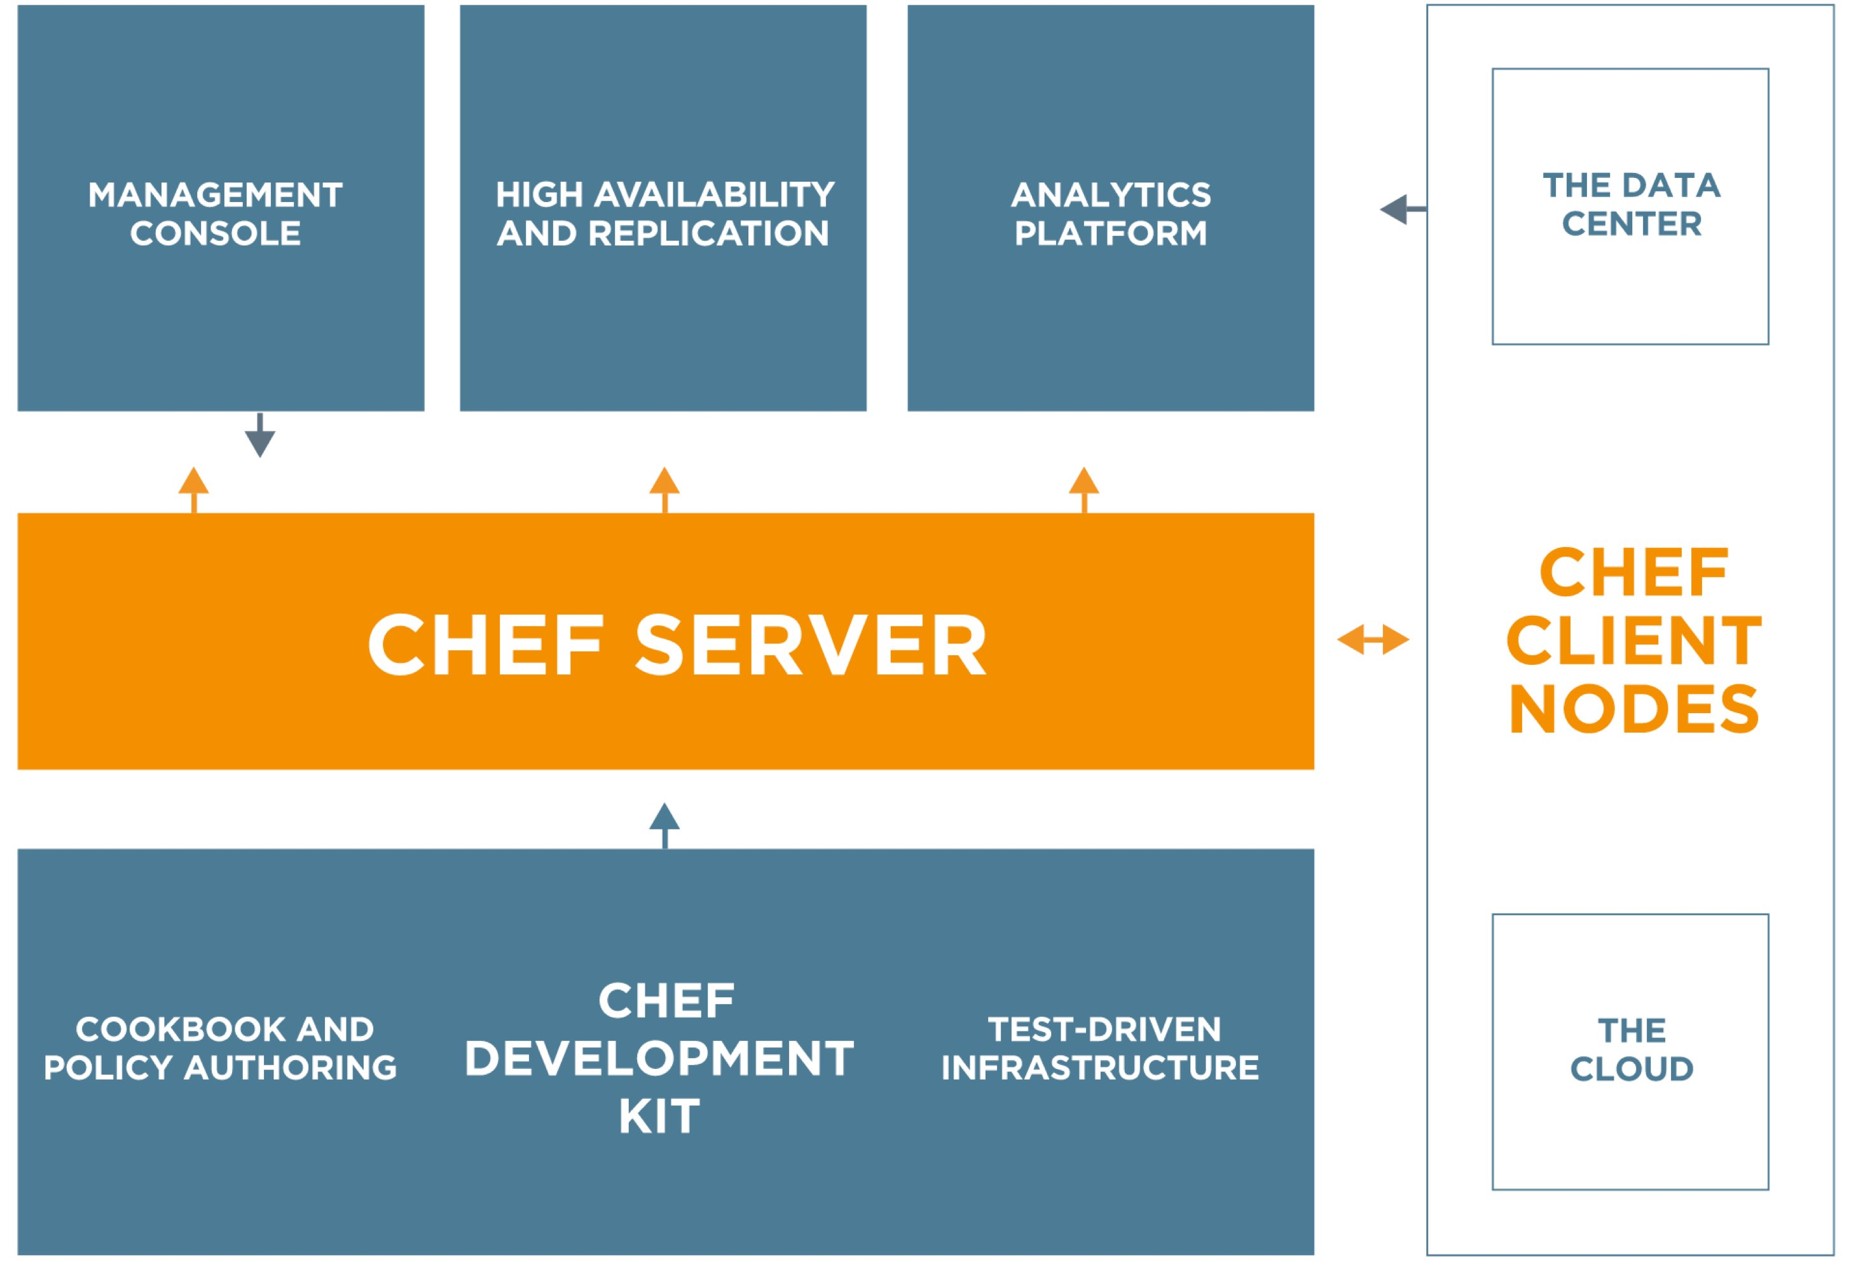
Chef
https://www.chef.io/chef/
Notes:
http://docs.chef.io/chef_overview.html

Slide 4
Automation Platform
Creates a dependable view of your entire network’s state.
Can handle complex dependencies among the nodes of your network.
Is fault tolerant.
Is secure.
Can handle multiple platforms
Can manage cloud resources
Provides a foundation for innovation

Slide 5
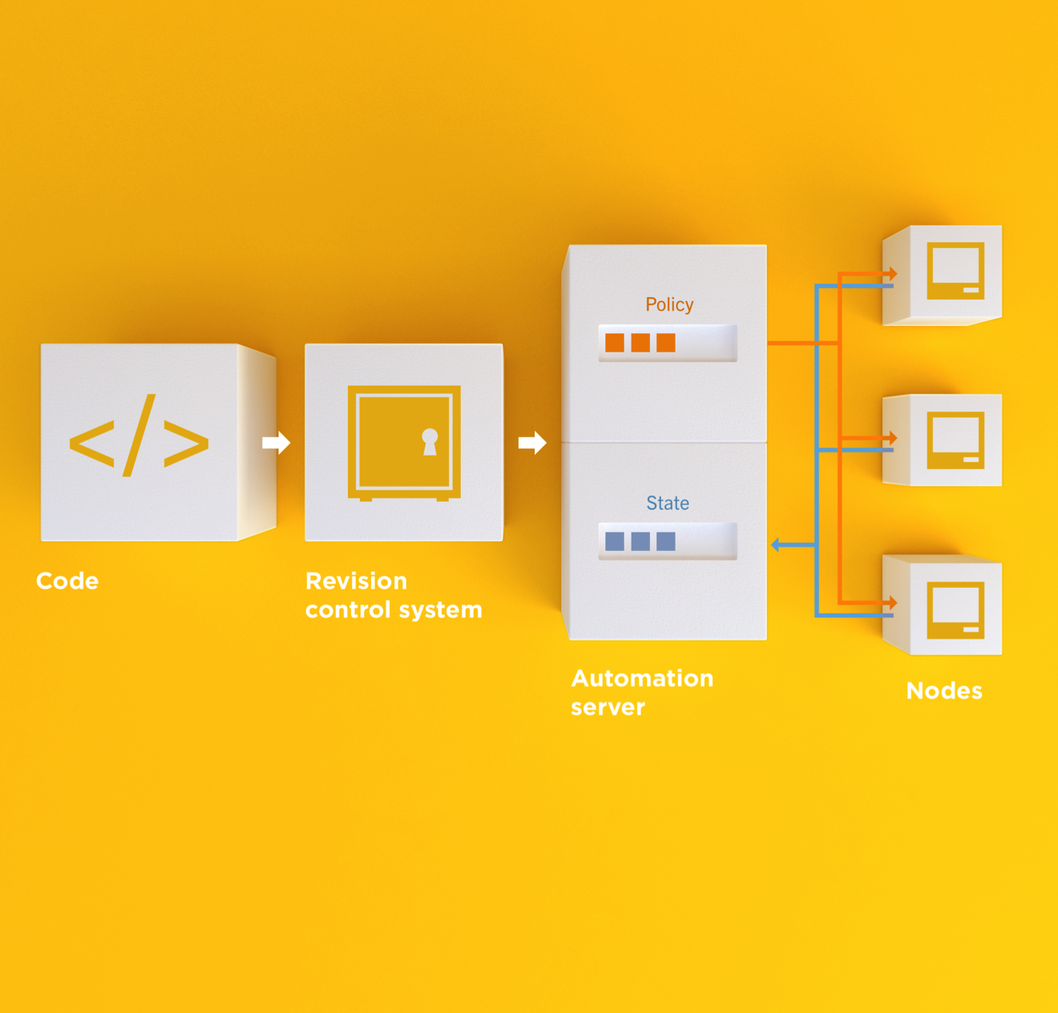
Infrastructure as Code
Programmatically provision and configure components
Notes:
Use the Chef framework and Chef programming language to define the components of your infrastructure. This allows you to capture and document the shape of your infrastructure in a consistent way.

Slide 6
Infrastructure as Code
Treat like any other code base
Notes:
Treat this like any other code base:
Store the code in a version control system.
Add automated tests to the code.
Refactor the code over time.
Build and version software artifacts (e.g. packages)
The code is executable documentation.
Store the code in a version control system.

Slide 7
Infrastructure as Code
Reconstruct business from code repository, data backup, and compute resources
Notes:
With your infrastructure now fully captured in code, you are now able to rebuild your entire business, well, at least all of your business’s applications, with your code repository, a backup of your data, and compute resources, be they bare metal, virtual machines, or cloud instances.

Slide 8
Infrastructure as Code
Programmatically provision and configure components
Treat like any other code base
Reconstruct business from code repository, data backup, and compute resources
Notes:
Stop for a minute and think about what we're saying here. Think about how freeing this can be. The next configuration change you need to make in production starts with a commit to your version control system. You can re-provision your infrastructure with another service provider; move from the data center to the clould and back again.How will this impact the way you run operations in your organization?What questions do you have?

Slide 9
Policy-based
You capture the policy for your infrastructure in code
A program ensures each node in your infrastructure complies with the policy
A control loop keeps the system stable and allows for change when policy is updated

Slide 10
Sample Infrastructure
Graphite
Nagios
Rails
Memcache
Postgres Slaves
Postgres Master

Slide 11
New Compliance Mandate!
Graphite
Nagios
Rails
Memcache
Postgres Slaves
Postgres Master

Slide 12
New Compliance Mandate!
Graphite
Nagios
Rails
Move SSH off of port 22
Let’s put it on 2022
Memcache
Postgres Slaves
Postgres Master

Slide 13
6 Golden Images to Update
Graphite
1
1
Nagios
1
1
1
1
1
Rails
1
1
Memcache
1
1
Postgres Slaves
1
Postgres Master

Slide 14
6 Golden Images to Update
Graphite
1
2
Nagios
3
Rails
/etc/ssh/sshd_config
--- a/sshd_config
+++ b/sshd_config
-Port 22
+Port 2202
4
Memcache
5
Postgres Slaves
6
Postgres Master

Slide 15
12 Instances to replace
Graphite
1
2
Nagios
3
4
5
6
7
Rails
Launch
Delete
Repeat
Typically manually
8
9
Memcache
10
11
Postgres Slaves
12
Postgres Master

Slide 16
Done in maintenance window
Graphite
1
2
Nagios
3
4
5
6
7
Rails
High stakes
Late hours
Risky change
8
9
Memcache
10
11
Postgres Slaves
12
Postgres Master

Slide 17
New configurations required?
Graphite
Nagios
Rails
Do the new instances have new IP Addresses?
* Not all connections shown
Memcache
Postgres Slaves
Postgres Master

Slide 18
Golden Images vs. Policy-based

Slide 19
Chef
Fast, scalable, flexible IT automation

Slide 20
What is Chef
Open source framework for managing complexity in your infrastructure through policy-driven automation code
A community of professionals
A company
Notes:
~60K professionals

Slide 21
Chef Server – Policy & State
Notes:
Policy –

Slide 22
Desired Configuration

Slide 23
Desired Configuration

Slide 24
Desired Configuration

Slide 25
Chef Server – Desired & Current State
Notes:
Policy –

Slide 26
HA Proxy Configuration

Slide 27
HA Proxy Configuration

Slide 28
HA Proxy Configuration

Slide 29
HA Proxy Configuration

Slide 30
HA Proxy Configuration

Slide 31
HA Proxy Configuration

Slide 32
HA Proxy Configuration

Slide 33
HA Proxy Configuration

Slide 34
Building your policy
Resources and Recipes
Notes:
Policy is defined as a collection of resources in recipes. There are lots of abstractions on top of this but resources are the basic building blocks.

Slide 35
Resources
Piece of the system and its desired state

Slide 36
Resources - Package
Package that should be installed
package "mysql-server" do
action :install
end

Slide 37
Resources - Service
Service that should be running and restarted on reboot
service "iptables" do
action [ :start, :enable ]
end

Slide 38
Resources - Service
File that should be generated
file "/etc/motd" do
content "Property of Chef Software"
end

Slide 39
Resources - Cron
Cron job that should be configured
cron "restart webserver" do
hour '2'
minute '0'
command 'service httpd restart'
end

Slide 40
Resources - User
User that should be managed
user "nginx" do
comment "Nginx user <nginx@example.com>"
uid 500
gid 500
supports :manage_home => true
end

Slide 41
Resources - DSC
DSC resource that should be run
dsc_script 'emacs' do
code <<-EOH
Environment 'texteditor'
{
Name = 'EDITOR'
Value = 'c:\\emacs\\bin\\emacs.exe'
}
EOH
end

Slide 42
Resources – Registry Key
Registry key that should be created
registry_key "HKEY_LOCAL_MACHINE\\SOFTWARE\\Microsoft\\Windows\\CurrentVersion\\Policies\\System" do
values [{
:name => "EnableLUA",
:type => :dword,
:data => 0
}]
action :create
end

Slide 43
Resources
Piece of the system and its desired state
http://docs.chef.io/chef/resources.html

Slide 44
Lab – Install a text editor
Problem: Our workstation does not have $EDITOR installed
Success Criteria: You can edit files with $EDITOR
$EDITOR is your favorite command line text editor: vim, emacs, or nano

Slide 45
What’s up with the card?
http://bit.ly/rails-chef-tdd
Login: chef
Password: [REDACTED]

Slide 46
Login to your lab machine
ssh chef@54.164.75.30
The authenticity of host '54.165.227.226 (54.165.227.226)' can't be established.
RSA key fingerprint is c1:ec:ab:66:fb:22:4a:8f:c2:c5:9b:26:77:f3:dd:b3.
Are you sure you want to continue connecting (yes/no)? yes
Warning: Permanently added '54.165.227.226' (RSA) to the list of known hosts.
chef@54.165.227.226's password:

Slide 47
Welcome to your workstation
ChefDK version 0.4.0 is installed
chef --version
Chef user has passwordless sudo access
sudo cat /etc/shadow

Slide 48
Is $EDITOR installed?
which vim
/usr/bin/which: no vim in (/opt/chefdk/bin:/home/chef/.chefdk/gem/ruby/2.1.0/bin:/opt/chefdk/embedded/bin:/usr/local/bin:/bin:/usr/bin:/usr/local/sbin:/usr/sbin:/sbin:/home/chef/bin)

Slide 49
chef-apply
chef-apply is an executable program that allows you to work with resources
Is included as part of the ChefDK
A great way to explore resources
NOT how you’ll eventually use Chef in production

Slide 50
Install vim
sudo chef-apply -e "package 'vim'"
Recipe: (chef-apply cookbook)::(chef-apply recipe)
* package[vim] action install
- install version 7.2.411-1.8.el6 of package vim-enhanced

Slide 51
Install emacs
sudo chef-apply -e "package 'emacs'"
Recipe: (chef-apply cookbook)::(chef-apply recipe)
* package[emacs] action install
- install version 23.1-25.el6 of package emacs

Slide 52
Install nano
sudo chef-apply -e "package 'nano'"
Recipe: (chef-apply cookbook)::(chef-apply recipe)
* package[nano] action install
- install version 2.0.9-7.el6 of package nano

Slide 53
Resources
Describe the desired state
Do not need to tell Chef how to get there
What happens if you re-run the chef-apply command?

Slide 54
Install $EDITOR again with chef-apply
sudo chef-apply -e "package 'vim'"
Recipe: (chef-apply cookbook)::(chef-apply recipe)
* package[vim] action install (up to date)

Slide 55
Test and Repair
Resources follow a test and repair model
package "vim"

Slide 56
Test and Repair
Resources follow a test and repair model
package "vim"
Is vim installed?
Test

Slide 57
Test and Repair
Resources follow a test and repair model
package "vim"
Is vim installed?
Test
Yes

Slide 58
Test and Repair
Resources follow a test and repair model
package "vim"
Is vim installed?
Test
Yes
Done

Slide 59
Test and Repair
Resources follow a test and repair model
package "vim"
Is vim installed?
Test
Yes
No
Done

Slide 60
Test and Repair
Resources follow a test and repair model
package "vim"
Is vim installed?
Test
Yes
No
Done
Install it

Slide 61
Test and Repair
Resources follow a test and repair model
package "vim"
Is vim installed?
Test
Yes
No
Repair
Done
Install it

Slide 62
Resources – Test and Repair
Resources follow a test and repair model
Resource currently in the desired state? (test)
Yes – Do nothing
No – Bring the resource into the desired state (repair)

Slide 63
Resources
package
template
service
directory
user
group
dsc_script
registry_key
powershell_script
cron
mount
route
…and more!
Notes:
Of course, there are lots of different types of resources that come with Chef
View them all on docs.chef.io/resources.html

Slide 64
Recipes
Policy is defined as a collection of resources in recipes. There are lots of abstractions on top of this but resources are the basic building blocks.

Slide 65
Install git
The package git should be installed
The file named '/home/chef/.gitconfig' should be created.
It should be owned by the chef user and group.
It should have the content:
[user]\n name=John Doe\n email=jdoe@example\n
Notes:
Give the students 5-10 minutes to complete this part of the lab.

Slide 66
Install git
~/git.rb
package 'git' do
action :install
end
file '/home/chef/.gitconfig' do
content "[user]\n name=John Doe\n email=jdoe@example\n"
user 'chef'
group 'chef'
end

Slide 67
Install git
sudo chef-apply ~/git.rb
Recipe: (chef-apply cookbook)::(chef-apply recipe)
* package[git] action install
- install version 1.7.1-3.el6_4.1 of package git
* file[/home/chef/.gitconfig] action create
- create new file /home/chef/.gitconfig
- update content in file /home/chef/.gitconfig from none to 259950
--- /home/chef/.gitconfig 2014-09-24 00:24:13.558127555 +0000
+++ /tmp/..gitconfig20140924-10180-1ij68vq 2014-09-24 00:24:13.559127555 +0000
@@ -1 +1,4 @@
+[user]
+ name=John Doe
+ email=jdoe@example.com
- change owner from '' to 'chef'
- change group from '' to 'chef'
- restore selinux security context

Slide 68
Test-driven Infrastructure
Change policy with confidence
Notes:
Let’s talk about Test Driving our Infrastructure

Slide 69
Our process
Write policy
Apply policy
Verify policy
Not bad for the simple case, will quickly get untenable
Notes:
Our process so far is to write a policy (a policy which would install an editor or git), then apply the policy to our workstation, then verify the policy manually. This is final for a simple case…but just like our ruby and rails code, testing it manually will quickly become untenable.

Slide 70
Faster Feedback
Speed-up the feedback loops with automated testing.
Have confidence in your changes before you run them in production
Notes:
I don’t think I need to spend too much time preaching to this crowd about the benefits of automated tests…but just like our application code, having tests around our infrastructure code will speed up the feedback loops and enable us to have confidence in changes before we push them to production

Slide 71
Chef Testing
Did chef-client complete successfully?
Did the recipe put the node in the desired state?
Are the resources properly defined?
Does the code follow our style guide?
Notes:
The ultimate purpose of tests is to tell us whether or not our code is safe to deploy. With our Chef code, there are four main questions we need to answer before we can deploy to production.
Did chef-client complete successfully?
Did the recipe put the node in the desired state?
Are the resources properly defined?
Does the code follow our style guide?
Over the next 30 minutes or so we’re going to go through how to answer each of these questions with automated tests.

Slide 72
Test-driving infrastructure
We are going to use a relatively simple scenario
We are going to explore many facets of testing
We are going to follow a test-first, test-driven model
Notes:
So let’s jump into answering these questions. We’re going to use a very simple scenario which will let us explore the many facets of test driving our infrastructure code.

Slide 73
Our Scenario
We want a simple rails app deployed on a server.
We will only have time to build some of it in today’s workshop.
You will leave with working code
Notes:
Here’s the scenario: we want to be able to deploy a simple rails app to a server we’ve configured with Chef using Test Driven Development. We won’t be able to build all of it in the time we have, but you will leave today with working code.

Slide 74
Create a directory for your Chef project
chef generate repo chef-repo
Compiling Cookbooks...
Recipe: code_generator::repo
* directory[/home/chef/chef-repo] action create
- create new directory /home/chef/chef-repo
* template[/home/chef/chef-repo/LICENSE] action create
- create new file /home/chef/chef-repo/LICENSE
- update content in file /home/chef/chef-repo/LICENSE from none to aed48c
(diff output suppressed by config)
* cookbook_file[/home/chef/chef-repo/README.md] action create
- create new file /home/chef/chef-repo/README.md
- update content in file /home/chef/chef-repo/README.md from none to 69567b
(diff output suppressed by config)
* cookbook_file[/home/chef/chef-repo/Rakefile] action create
- create new file /home/chef/chef-repo/Rakefile
Notes:
First, let’s create a new chef-repo for your chef project. Go ahead and run chef generate repo chef-repo. Nathen is going to be running the code as the same time as you, and he’ll give me a thumbs up when the command is complete.

Slide 75
Change into that directory
cd cookbooks
Notes:
Now let’s cd into our cookbooks directory

Slide 76
Create an apache cookbook
chef generate cookbook cookbooks/apache
Compiling Cookbooks...
Recipe: code_generator::cookbook
* directory[/home/chef/chef-repo/cookbooks/apache] action create
- create new directory /home/chef/chef-repo/cookbooks/apache
* template[/home/chef/chef-repo/cookbooks/apache/metadata.rb] action create_if_missing
- create new file /home/chef/chef-repo/cookbooks/apache/metadata.rb
- update content in file /home/chef/chef-repo/cookbooks/apache/metadata.rb from none to 4c0e2d
(diff output suppressed by config)
* template[/home/chef/chef-repo/cookbooks/apache/README.md] action create_if_missing
Notes:
We’re going to first write a cookbook to install and configure Apache. Use chef generate cookbook cookbooks/apache to generate the initial cookbook, the Chef DK will generate a bunch of scaffolding for our cookbook.

Slide 77
Questions to ask when testing
Did chef-client complete successfully?
Did the recipe put the node in the desired state?
Are the resources properly defined?
Does the code following our style guide?
Notes:
So the first question we need to answer is whether our chef-client run completed successfully.

Slide 78
Chef client success status
Requirements to verify chef-client success:
A place to store the cookbook artifact
Notes:
In order to do this, we need to verify that 1) We have a place to store the cookbook artifact

Slide 79
Chef client success status
Requirements to verify chef-client success:
A place to store the cookbook artifact
A chef-client with access to the cookbook
Notes:
2) That we have a chef-client with access to the cookbook

Slide 80
Chef client success status
Requirements to verify chef-client success:
A place to store the cookbook artifact
A chef-client with access to the cookbook
A target server running the same OS as production
Notes:
And 3) That we have a target server which is running the same OS as our production server.

Slide 81

Test Kitchen
Test harness to execute code on one or more platforms
Driver plugins to allow your code to run on various cloud and virtualization providers
Includes support for many testing frameworks
Included with ChefDK
Notes:
To do this, we’re going to use Test Kitchen! Test Kitchen is a delightful tool which allows us to spin up a VM or container, configure it with our Chef code, then verify that the VM or container is in the state we expect it to be after our Chef run is complete.

Slide 82
Test Matrix
Two operating systems
ubuntu-12.04
centos-6.4
Notes:
One of the nicest things about Test Kitchen is that we can test that our Chef code on multiple operating systems. I can test whether the same cookbook will work on both Ubuntu-12.04 and Centos 6.4

Slide 83
Test Matrix
Two operating systems
One recipe
 | default
ubuntu-12.04 | apache::default
centos-6.4 | apache::default
Notes:
I can then define which recipes in that cookbook I want to test and test that recipe on both platforms.

Slide 84
Test Matrix
Two operating systems
Two recipes
 | default | ssl
ubuntu-12.04 | apache::default | apache::ssl
centos-6.4 | apache::default | apache::ssl
Notes:
And if I have multiple recipes within the same cookbook, I can test all of them on both platforms.

Slide 85
Test Matrix
Three operating systems
Two recipes
 | default | ssl
ubuntu-12.04 | apache::default | apache::ssl
centos-6.4 | apache::default | apache::ssl
ubuntu-14.04 | apache::default | apache::ssl
Notes:
I can even add another operating system and run those same test suites on that operating system. Isn’t this delightful?

Slide 86
Configuring the Kitchen
cookbooks/apache/.kitchen.yml
---
driver:
name: vagrant
provisioner:
name: chef_zero
platforms:
- name: ubuntu-12.04
- name: centos-6.4
suites:
- name: default
run_list:
- recipe[apache::default]
attributes:
Notes:
So we configure what operating systems and what recipes we want to test in our .kitchen.yml file within the cookbooks. So go ahead and open up cookbooks/apache/.kitchen.yml and take a look at it.

Slide 87
.kitchen.yml
driver - virtualization or cloud provider
---
driver:
name: vagrant
provisioner:
name: chef_zero
platforms:
- name: ubuntu-12.04
- name: centos-6.4
suites:
- name: default
run_list:
- recipe[apache::default]
attributes:
Notes:
Let’s go through this file step by step. The first thing we declare is what driver we want to use. This defines where Test Kitchen will attempt to spin up an instance to test the recipe. This can be vagrant, it can be a cloud provider – I tend to use Digital Ocean when running test kitchen on a cloud provider because it’s nice and fast, or it can be a container provisioning tool like Docker

Slide 88
.kitchen.yml
provisioner - application to configure the node
---
driver:
name: vagrant
provisioner:
name: chef_zero
platforms:
- name: ubuntu-12.04
- name: centos-6.4
suites:
- name: default
run_list:
- recipe[apache::default]
attributes:
Notes:
Next thing we declare is how we’re going to simulate a chef-client run on our test instance – since our test instance won’t be connected to a Chef server. We can use either chef_zero as we do here, or chef_solo. I like to use Chef Zero because it runs in memory and is nice and fast for testing.

Slide 89
.kitchen.yml
platforms - target operating systems
---
driver:
name: vagrant
provisioner:
name: chef_zero
platforms:
- name: ubuntu-12.04
- name: centos-6.4
suites:
- name: default
run_list:
- recipe[apache::default]
attributes:
Notes:
Next is platforms, these are the OS we want to test the Chef code on.

Slide 90
.kitchen.yml
suites - target configurations
---
driver:
name: vagrant
provisioner:
name: chef_zero
platforms:
- name: ubuntu-12.04
- name: centos-6.4
suites:
- name: default
run_list:
- recipe[apache::default]
attributes:
Notes:
Suites are ways to group recipes to test. The run list of a suite defines which recipes will be applied to our Test Kitchen instance. Attributes allows us to add in values that we would expect to find on the server, but can’t necessarily know until we actually spin it up. I could provide a mock IP address as an attribute, then execute tests and verify that my Chef code finds that IP address and uses it as I expect it to. It’s similar to a stub or mock.

Slide 91
.kitchen.yml
 | default
ubuntu-12.04 | apache::default
centos-6.4 | apache::default
---
driver:
name: vagrant
provisioner:
name: chef_zero
platforms:
- name: ubuntu-12.04
- name: centos-6.4
suites:
- name: default
run_list:
- recipe[apache::default]
Notes:
A test suite can run multiple recipes. So we can have a default suite suite which will run our default recipe…

Slide 92
.kitchen.yml
 | default | ssl
ubuntu-12.04 | apache::default | apache::ssl
centos-6.4 | apache::default | apache::ssl
---
driver:
name: vagrant
provisioner:
name: chef_zero
platforms:
- name: ubuntu-12.04
- name: centos-6.4
suites:
- name: default
run_list:
- recipe[apache::default]
- name: ssl
run_list:
- recipe[apache::ssl]
Notes:
And we could have another suite which would test a recipe called ssl, which would configure ssl for apache.

Slide 93
.kitchen.yml
 | default | ssl
ubuntu-12.04 | apache::default | apache::ssl
centos-6.4 | apache::default | apache::ssl
ubuntu-14.04 | apache::default | apache::ssl
---
driver:
name: vagrant
provisioner:
name: chef_zero
platforms:
- name: ubuntu-12.04
- name: centos-6.4
- name: ubuntu-14.04
suites:
- name: default
run_list:
- recipe[apache::default]
- name: ssl
run_list:
- recipe[apache::ssl]
Notes:
I can also easily add additional operating systems I want to verify my Chef code works on.

Slide 94
Move to the apache cookbook directory
cd ~/chef-repo/cookbooks/apache
Notes:
So let’s move to that cookbook directory

Slide 95
Update .kitchen.yml
.kitchen.yml
---
driver:
name: docker
provisioner:
name: chef_zero
platforms:
- name: ubuntu-12.04
suites:
- name: default
run_list:
- recipe[apache::default]
attributes:
Notes:
And update our .kitchen.yml file.
We’re going to update the driver – all the cool kids are using docker these days, so let’s use that as our driver.
We’re going to leave the provisioner as chef_zero, keep it nice and fast
Let’s only test this on ubuntu-12.04 for now, so go ahead and remove the centos line
And for now we’re only going to define the default suite and the only recipe we need in our run list is the default recipe
Then save and close the file…I’ll give you minute or so to make these changes.

Slide 96
List the Test Kitchens
kitchen list
Instance Driver Provisioner Last Action
default-ubuntu-1204 Docker ChefZero <Not Created>
Notes:
Back at the command line, run the command kitchen list. This shows us all the “kitchens” we have configured – in this case, it’s only one. Our kitchen will run the default suite on Ubuntu 1204 using Docker and Chef Zero. Were we to add another operating system or test suite, we’re also see that on this list.

Slide 97
Create the kitchen
kitchen create
-----> Starting Kitchen (v1.3.1)
-----> Creating <default-ubuntu-1204>...
Sending build context to Docker daemon 2.56 kB
Sending build context to Docker daemon
Step 0 : FROM ubuntu:12.04
---> 0b310e6bf058
Step 1 : RUN dpkg-divert --local --rename --add /sbin/initctl
---> Running in 73201c2a8836
Leaving 'local diversion of /sbin/initctl to /sbin/initctl.distrib'
---> c8039cd87665
Removing intermediate container 73201c2a8836
Step 2 : RUN ln -sf /bin/true /sbin/initctl
---> Running in 4e79ba940fe4
---> ecc3ffe49a30
Removing intermediate container 4e79ba940fe4
Notes:
So now that we have it defined it in our kitchen.yml, it’s time to actually create the docker instance. We do this by running the kitchen create command. Let’s go ahead and run that, and it will take a couple of minutes to run. While we’re waiting, here’s a demo from Nathen on what the mysql community cookbook uses for test kitchens.

Slide 98
Kitchen created
Workstation
Kitchen
Notes:
Now that our kitchen is up, here’s a visual representation of what we just did. We have our workstation, then within that workstation we’re running a docker container with our kitchen inside it. We’re going to run tests from our workstation on the kitchen.

Slide 99
Login to the kitchen
kitchen login
kitchen@localhost's password:
Notes:
One of the nice things about Test Kitchen is that we can login to the container where it is running. Run kitchen login

Slide 100
Login to the kitchen
kitchen login
kitchen@localhost's password:
kitchen
Notes:
Then when it prompts you for a password, use the word “kitchen”

Slide 101
Login to the kitchen
kitchen login
kitchen@localhost's password:
Last login: Wed Sep 24 04:30:29 2014 from 172.17.42.1
kitchen
Notes:
And now we’re within that docker container on our workstation.

Slide 102
Kitchen login
Workstation
Kitchen
Notes:
To demonstrate this visually, we again have our workstation with a container running kitchen inside it.

Slide 103
Kitchen login
Workstation
Kitchen
[chef@ip-172-31-44-173 apache]$ kitchen login
Notes:
Then we run kitchen login from our workstation

Slide 104
Kitchen login
Workstation
Kitchen
ssh
[chef@ip-172-31-44-173 apache]$ kitchen login
Notes:
And this ssh’es into our kitchen container

Slide 105
Kitchen login
Workstation
Kitchen
[kitchen@5379d310dc59 ~]$
ssh
[chef@ip-172-31-44-173 apache]$ kitchen login
Notes:
And now we can run commands within that container.

Slide 106
Chef client success status
Requirements to verify chef-client success:
A target server running the same OS as production
A chef-client with access to the cookbook
Notes:
So in order to verify our chef-client runs successfully, remember that we need a target server running the same OS as production, and a chef-client with access to the cookbook

Slide 107
Lab – Apply our policy
Problem: We have not applied our policy to the test environment.
Success Criteria: The default apache recipe will be applied in the test environment
Notes:
So now let’s do some lab work and actually apply our Chef policy to this testing docker instance.

Slide 108
Leave the kitchen
exit
logout
Connection to localhost closed.
Notes:
So go ahead and exit your kitchen docker instance the usual way, with “exit”

Slide 109
Go to the right place
cd ~/chef-repo/cookbooks/apache
Notes:
And make sure you’re within your apache cookbook directory on your workstation

Slide 110
Apply our policy
kitchen converge
-----> Starting Kitchen (v1.3.1)
-----> Converging <default-ubuntu-1204>...
Preparing files for transfer
Preparing dna.json
Resolving cookbook dependencies with Berkshelf 3.2.3...
Removing non-cookbook files before transfer
Preparing validation.pem
Preparing client.rb
-----> Installing Chef Omnibus (install only if missing)
downloading https://www.chef.io/chef/install.sh
to file /tmp/install.sh
trying wget...
sudo: /etc/sudoers.d/kitchen is mode 0644, should be 0440
Downloading Chef for ubuntu...
Notes:
Our next step is to run the command kitchen converge. This installs Chef if it’s not already installed and…

Slide 111
Kitchen converge
Workstation
Kitchen
Install Chef
Upload cookbooks
Apply the run_list
Notes:
Uploads our cookbooks, then applies our run list. Remember we defined that run list in .kitchen.yml
Any Q and A while we’re waiting for that to run?

Slide 112
Questions to ask when testing
Did chef-client complete successfully?
Did the recipe put the node in the desired state?
Are the resources properly defined?
Does the code following our style guide?
Notes:
So when kitchen converge runs successfully, we can answer that first question. The chef-client run did indeed complete successfully! Congratulations, you’ve just completed your first test driven chef run without writing any tests or code at all! Now let’s move onto the next question…

Slide 113
Verifying node state
Serverspec
Notes:
We need to verify our node state…

Slide 114
Manually inspect the test node
kitchen login
kitchen@localhost's password:
Notes:
We could do this through manual testing on the container. Go ahead and run kitchen login again:

Slide 115
Manually inspect the test node
kitchen login
kitchen@localhost's password:
kitchen
Notes:
And remember to use the password “kitchen”

Slide 116
Manually inspect the test node
kitchen login
kitchen@localhost's password:
Last login: Wed Sep 24 04:30:29 2014 from 172.17.42.1
kitchen
Notes:
And that gets us into our testing container.

Slide 117
Manually inspect the test node
curl http://localhost
curl: (7) couldn't connect to host
Notes:
Now let’s test whether Apache is running. If it is, we’ll be able to run curl http://localhost and get a successful response. But, when we run this, we get an error back. This means Apache is not running within our testing container.

Slide 118
Kitchen login
Workstation
Kitchen
[kitchen@5379d310dc59 ~]$ curl http://localhost
curl: (7) couldn't connect to host
ssh
[chef@ip-172-31-44-173 apache]$ kitchen login
Notes:
Here’s another visual, just reminding you that we are ssh’d from our workstation into our kitchen container and are running the curl command from inside the kitchen container.

Slide 119
Lab – Verify node state
Problem: Manually verifying the state of the test node is tedious and error-prone.
Success Criteria: The end state of the node is automatically tested.
Notes:
Now this worked….but this is a tedious and error prone process. [ Pause ] There is a better way. Let’s use this lab time to develop a solution which will automatically test the end state of our node.

Slide 120

Serverspec
Write tests to verify your servers
Not dependent on Chef
Defines many resource types
package, service, user, etc.
Works well with Test Kitchen
http://serverspec.org/
Notes:
To do this, we’re going to use a tool called serverspec which allows us to write tests to verify the state of servers. It’s not limited to Chef – you can use it with Puppet, Ansible, etc. Serverspec defines many resource types- just like Chef- to describe what state we expect to find our infrastructure in. It works extremely well with Test Kitchen and is a delight to use.

Slide 121
Leave the Kitchen
exit
logout
Connection to localhost closed.
Notes:
So go ahead and exit out of your testing container.

Slide 122
Move to the proper directory
cd ~/chef-repo/cookbooks/apache
Notes:
And make sure you’re in your apache cookbook directory

Slide 123
Write a Serverspec test
test/integration/default/serverspec/default_spec.rb
require 'spec_helper'
describe 'apache::default' do
# Serverspec examples can be found at
# http://serverspec.org/resource_types.html
it 'does something' do
skip 'Replace this with meaningful tests'
end
end
Notes:
And now let’s write a ServerSpec test. Open up test/integration/default/serverspec/default_spec.rb with your editor of choice and this is what you’re going to see. When we generated this cookbook with Chef DK, it also generated a serverspec file for our default recipe. If you’re an rspec user, this syntax should look very familiar

Slide 124
Generic Expectation Form
describe "<subject>" do
it "<description>" do
expect(thing).to eq result
end
end
Notes:
Let’s take a closer we use a describe block to define the subject of our test, then we use it blocks to describe what we expect that subject to do or be doing. We use the same expect syntax that rspec uses to define what we expect the results of our code to be.

Slide 125
Awesome Expectations
test/integration/default/serverspec/default_spec.rb
require 'spec_helper’
describe "apache::default" do
it "is awesome" do
expect(true).to eq true
end
end
Notes:
So let’s add in an actual test. Within that describe block – the one that describes the default recipe of our Apache cookbook – let’s add in a test to ensure that our recipe is awesome. When our recipes are awesome we are awesome. Then save and close the file.

Slide 126
Run the serverspec test
kitchen verify
-----> Running serverspec test suite
/opt/chef/embedded/bin/ruby -I/tmp/busser/suites/serverspec -I/tmp/busser/gems/gems/rspec-support-3.1.2/lib:/tmp/busser/gems/gems/rspec-core-3.1.7/lib /opt/chef/embedded/bin/rspec --pattern /tmp/busser/suites/serverspec/\*\*/\*_spec.rb --color --format documentation --default-path /tmp/busser/suites/serverspec
apache::default
is awesome
Finished in 0.02823 seconds (files took 0.99875 seconds to load)
1 example, 0 failures
Finished verifying <default-centos-64> (0m5.03s).
Notes:
And run the command “kitchen verify” – this will run the actual tests on our test kitchen container. This will take a little bit to run…ultimately we should see a success – our recipe is indeed awesome.

Slide 127
How would you test our criteria?
What would you test to make sure apache is running?
Notes:
So now this brings us to the question – how do we test to make sure Apache is running? What would you test?

Slide 128
Verify package is installed
test/integration/default/serverspec/default_spec.rb
require 'spec_helper'
describe "apache" do
it "is awesome" do
expect(true).to eq true
end
it "is installed" do
expect(package("apache2")).to be_installed
end
end
Notes:
Let’s add in a test to check whether Apache is installed. Open up your serverspec file and add in the test:
And why we’re here, let’s add in some pending tests, Nathen’s going to plug in and demo this live. What other tests would you add to ensure Apache is running?

Slide 129
Exercise the test
kitchen verify
apache::default
is awesome
is installed (FAILED - 1)
Failures:
1) apache::default is installed
Failure/Error: expect(package 'apache2').to be_installed
expected Package "apache2" to be installed
/bin/sh -c dpkg-query\ -f\ \'\$\{Status\}\'\ -W\ apache2\ \|\ grep\ -E\ \'\^\(install\|hold\)\ ok\ installed\$\'
No packages found matching apache2.
Notes:
And run kitchen verify. It errors out telling us that the Apache 2 package is not installed. And this is good. It’s always good to see a failure when we first run a test.

Slide 130
Test is failing, make it pass
Test-driven development involves
Write a test to verify something is working
Watch the test fail
Write just enough code to make the test pass
Repeat
Notes:
So you probably already know this – but just like in application code - test driven infrastructure code involves writing a test, watching it fail, writing just enough code to make it pass, then repeating. So we’ve written a test and watched it fail, now let’s add in the code to make it pass.

Slide 131
Update our cookbook
~/chef-reop/cookbooks/apache/recipes/default.rb
package "apache2"
Notes:
Open up your default recipe at recipes/default.rb and add in just one line:

Slide 132
Converge the node again
kitchen converge
-----> Starting Kitchen (v1.3.1)
-----> Converging <default-ubuntu-1204>...
Preparing files for transfer
Preparing dna.json
Resolving cookbook dependencies with Berkshelf 3.2.3...
Removing non-cookbook files before transfer
Preparing validation.pem
Preparing client.rb
-----> Chef Omnibus installation detected (install only if missing)
sudo: /etc/sudoers.d/kitchen is mode 0644, should be 0440
Transferring files to <default-ubuntu-1204>
sudo: /etc/sudoers.d/kitchen is mode 0644, should be 0440
Starting Chef Client, version 12.2.1
[2015-04-15T22:02:01+00:00] WARN: Child with name 'dna.json' found in multiple directories: /tmp/kitchen/dna.json and /tmp/kitchen/dna.json
resolving cookbooks for run list: ["apache::default"]
Notes:
Now run kitchen converge to apply our chef recipe. This installs Chef and our cookbooks onto our test kitchen instance or container.

Slide 133
Exercise the test
kitchen verify
apache
is awesome
is installed
Finished in 0.48165 seconds (files took 1.05 seconds to load)
2 examples, 0 failures
Finished verifying <default-centos-64> (0m5.64s).
-----> Kitchen is finished. (0m11.84s)
Notes:
And run “kitchen verify” one more time. This time, we should see a success!

Slide 134
What else will you test?
Is the service running?
Is the port accessible?
Is the expected content being served?
Make sure everything works from a fresh kitchen, too!
Notes:
So we added some pending tests in earlier. Let’s add in code to make these executablel tests, watch them fail, then make them pass.

Slide 135
Extend the Serverspec test
test/integration/default/serverspec/default_spec.rb
describe 'apache' do
it "is installed" do
expect(package 'apache2').to be_installed
end
it "is running" do
expect(service 'apache2').to be_running
end
it "responds to http requests" do
expect(command("curl localhost").exit_status).to eq 0
end
end
Notes:
So let’s go through a few that we could add- it is running, and it responds to http requests.

Slide 136
Verify the kitchen
kitchen verify
Failures:
1) apache::default is running
Failure/Error: expect(service 'apache2').to be_running
expected Service "apache2" to be running
/bin/sh -c service\ apache2\ status\ \&\&\ service\ apache2\ status\ \|\ grep\ \'running\'
Apache2 is NOT running.
2) apache::default responds to http requests
Failure/Error: expect(command("curl localhost").exit_status).to eq 0
expected: 0
got: 7
Notes:
Now let’s run these tests and we see a couple of failures. Our tests indicate that Apache is not running on our test kitchen container and that it is also not responding to http requests.

Slide 137
Update our cookbook
~/chef-repo/cookbooks/apache/recipes/default.rb
package "apache2”
service "apache2” do
action :start
end
Notes:
Now let’s write the code to make these pass. On Ubuntu 12.04, it’s not enough to just install the package. We also have to start the apache2 service. We do that by adding in service block, telling Chef to start the Apache2 service after installing it.

Slide 138
Converge the node again
kitchen converge
-----> Starting Kitchen (v1.3.1)
-----> Converging <default-ubuntu-1204>...
Preparing files for transfer
Preparing dna.json
Resolving cookbook dependencies with Berkshelf 3.2.3...
Removing non-cookbook files before transfer
Preparing validation.pem
Preparing client.rb
-----> Chef Omnibus installation detected (install only if missing)
sudo: /etc/sudoers.d/kitchen is mode 0644, should be 0440
Transferring files to <default-ubuntu-1204>
sudo: /etc/sudoers.d/kitchen is mode 0644, should be 0440
Starting Chef Client, version 12.2.1
[2015-04-15T22:02:01+00:00] WARN: Child with name 'dna.json' found in multiple directories: /tmp/kitchen/dna.json and /tmp/kitchen/dna.json
resolving cookbooks for run list: ["apache::default"]
Notes:
Now run kitchen converge to apply our changes to our test kitchen container

Slide 139
Verify the kitchen
kitchen verify
apache::default
is awesome
is installed
is running
responds to http requests
Finished in 0.9764 seconds (files took 1.22 seconds to load)
4 examples, 0 failures
Finished verifying <default-ubuntu-1204> (0m9.78s).
-----> Kitchen is finished. (0m11.23s)
Notes:
And run those tests. This time, they pass!

Slide 140
Kitchen Workflow
kitchen create
kitchen converge
kitchen verify
kitchen destroy
All at once with kitchen test
Notes:
As you’ve seen, there are four main commands that take us through the Test Kitchen workflow
Kitchen create – creates our test kitchen container or instance
Kitchen converge – installs Chef and applies our Chef cookbooks
Kitchen verify – runs the actual tests against the test kitchen container
Kitchen destroy –destroys the test kitchen container or instance
You can run all four of these commands, one after the other, using “kitchen test”

Slide 141
Chef Testing
Did chef-client complete successfully?
Did the recipe put the node in the desired state?
Are the resources properly defined?
Does the code following our style guide?
Notes:
So now we’ve answered our second question, verifying that our default recipe of our apache cookbook did indeed put the node in the desired state.

Slide 142
Even Faster Feedback
ChefSpec
Notes:
Now Test Kitchen is a wonderful tool for integration style testing…but there are times we want faster feedback than what we can get when we need to fully converge a VM or container.

Slide 143
Chef Testing
Did chef-client complete successfully?
Did the recipe put the node in the desired state?
Are the resources properly defined?
Does the code following our style guide?
Notes:
In particular, we want fast feedback when testing whether our resources are properly defined.

Slide 144
This is too slow!
To test our code, we need to spin up a test kitchen, converge a node, execute some tests.
Our simple test case takes about 2 minutes to fully execute.
Notes:
Testing using test kitchen and server spec take about 2 minutes, sometimes more depending on which driver you’re using, to fully execute. That’s 2 or more minutes waiting for feedback when we could be moving on with our code.

Slide 145
Properly configured resources
We need a way to verify that the resources in our recipes are properly configured
We want to get faster feedback
Notes:
We need to verify that our recipes work, and we also need a way to get fast feedback

Slide 146
Lab – Verify the resources
Problem: We should be able to catch errors before we need to converge a node
Success Criteria: Catch a typo prior to converge
Notes:
So let’s demonstrate this with a lab. Our problem we need solve is to catch errors before we need to converge the node. The success criteria to check whether we’ve solved this problem is the ability to catch a typo prior to converge.

Slide 147
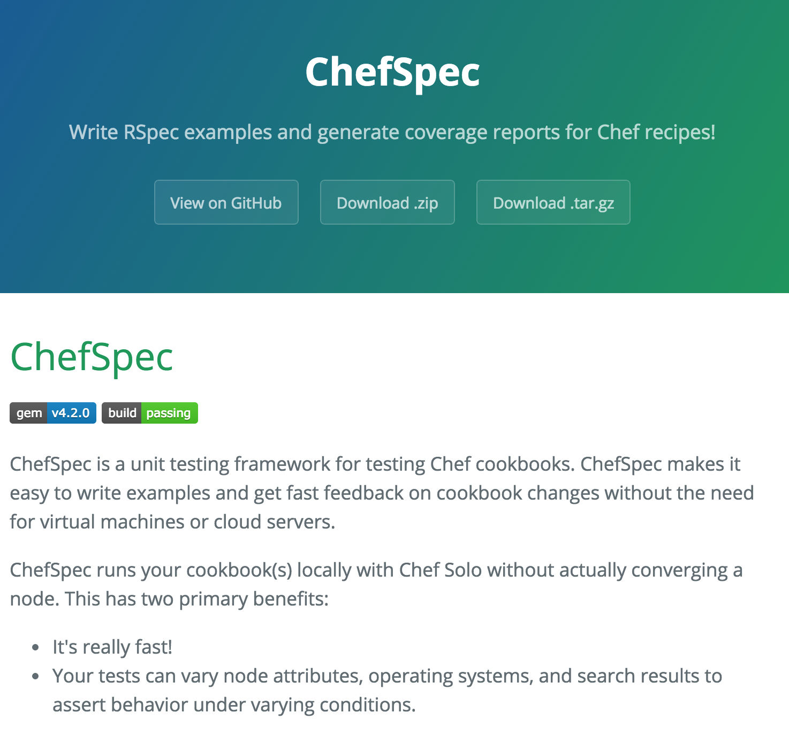
ChefSpec
Test before you converge
Get feedback on cookbook changes without the need for target servers
http://sethvargo.github.io/chefspec/
Notes:
And the tool we’re going to use is called ChefSpec. ChefSpec allows you to write unit tests in rspec and run them locally without ever needing to converge a test VM. Or container It’s a fantastic way to both write and execute unit tests, the iterate on our code quickly.

Slide 148
Change to the apache cookbook directory
cd ~/chef-repo/cookbooks/apache
Notes:
Let’s create a chefspec test. First, make sure you’re in your apache cookbook directory.

Slide 149
Write a ChefSpec test
spec/unit/recipes/default_spec.rb
require 'spec_helper'
describe 'apache::default' do
context 'When all attributes are default, on an unspecified platform' do
let(:chef_run) do
runner = ChefSpec::ServerRunner.new
runner.converge(described_recipe)
end
it 'converges successfully' do
chef_run # This should not raise an error
end
end
end
Notes:
When we generate a cookbook, Chef DK automatically generates a chef spec file for our default recipe. Go ahead and open that up and take a look. We’re using the describe block to declare the subject of the our tests – the default recipe of the Apache cookbook. Then we define a context – when all attributes are default, on an unspecified platform. Then we use some built in Chef Spec magic to do a chef client run and converge locally on our workstation. Then we test that it works successfully, saying that the chef_run should not raise an error.

Slide 150
Write a ChefSpec test
spec/unit/recipes/default_spec.rb
describe 'apache::default' do
context 'When all attributes are default, on an unspecified platform' do
let(:chef_run) do
runner = ChefSpec::ServerRunner.new
runner.converge(described_recipe)
end
it 'converges successfully' do
chef_run # This should not raise an error
end
it 'installs apache' do
expect(chef_run).to install_package 'apache2'
end
end
end
Notes:
Now let’s add in a test of our own. Let’s test that a Chef run will install the package ‘apache2’. Then save and exit the file.

Slide 151
Run the ChefSpec tests
rspec spec
..
Finished in 1.19 seconds (files took 13.09 seconds to load)
2 examples, 0 failures
Notes:
Now let’s run those tests. ChefSpec tests are rspec tests, and therefore we can run them with the usual rspec command. And they pass. But…having a test pass on the first try is not a good thing. Let’s make sure it fails.

Slide 152
Break the cookbook
recipes/default.rb
package "apache"
service "apache2" do
action :start
end
Notes:
Let’s open up our default recipe and break it. Change the package “apache2” declaration to “apache”.

Slide 153
Run the ChefSpec tests
rspec spec
.F
Failures:
1) apache::default When all attributes are default, on an unspecified platform installs apache
Failure/Error: expect(chef_run).to install_package 'apache2'
expected "package[apache2]" with action :install to be in Chef run. Other package resources:
package[apache]
# ./spec/unit/recipes/default_spec.rb:23:in `block (3 levels) in <top (required)>'
Finished in 1.18 seconds (files took 12.7 seconds to load)
2 examples, 1 failure
Notes:
Then run the tests. And it fails, that means the test does what we think it does!

Slide 154
Fix the cookbook
recipes/default.rb
package "apache2"
service "apache2" do
action :start
end
Notes:
So now let’s change it back and make that test pass.

Slide 155
Run the ChefSpec tests
rspec spec
..
Finished in 1.19 seconds (files took 13.09 seconds to load)
2 examples, 0 failures
Notes:
Now let’s run the tests again. And this time it passes!

Slide 156
Chef Testing
Did chef-client complete successfully?
Did the recipe put the node in the desired state?
Are the resources properly defined?
Does the code following our style guide?
Notes:
And we’ve answered our third question – the resources are properly defined! Were we to continue with this, I would add in another test to make sure that we start our Apache service. Now that we have these unit tests in, what Apache serverspec tests would you remove?
- Can take out looking for the package, would want to leave in curling (regardless of how package is installed, would need to curl to be sure that finished server works)

Slide 157
Clean code
Follow best practices, avoid mistakes
Notes:
There’s one more thing we want to test for – making sure our code is clean and that it avoids common syntax errors and poor practices.

Slide 158

Foodcritic
Check cookbooks for common problems
Style, correctness, deprecations, etc.
Included with ChefDK
http://www.foodcritic.io/
Notes:
To do this, we’re going to include a tool called Food Critic. Food Critic is a linting tool – it doesn’t actually execute the code, but it does check it for quality including styling, correctness, and making sure your code is not using things that are deprecated. Food Critic is included with the Chef DK. Same concept as rubocop or tailor.

Slide 159
Change our recipe
recipes/default.rb
package_name = "apache2"
package "#{package_name}"
service "apache2" do
action :start
end
Notes:
So now let’s change our recipe: We’re going to declare a string called package_name, then interpolate that string in our package resource

Slide 160
Run Foodcritic
foodcritic .
FC002: Avoid string interpolation where not required: ./recipes/default.rb:7
Notes:
Now let’s run food critic… and it warns us that our string interpolation is not required. Although it doesn’t break anything, it adds some unnecessary complexity to the code that can easily be avoided.

Slide 161
Chef Testing
Did chef-client complete successfully?
Did the recipe put the node in the desired state?
Are the resources properly defined?
Does the code following our style guide?
Notes:
So we’ve now successfully answered all the questions required for Chef Testing.

Slide 162
Next steps
Install ruby on the system
Install and configure passenger
Install and configure a database
Deploy the application
Demo the working solution
Notes:
We’ll work through as much of this as we can with the class leaving time for a full demo in the end
Participants will not be able to install the database in the docker instances but can do everything else

Slide 163
Wrapping Up

Slide 164
We’ve only scratched the surface
https://www.chef.io/chef/
Notes:
All Open Source!

Slide 165
Build Anything
Simple internal applications
Complex external applications
Workstations
Hadoop clusters
IaaS infrastructure
PaaS infrastructure
SaaS applications
Storage systems
You name it
http://www.flickr.com/photos/hyku/245010680/

Slide 166
And Manage it Simply
Automatically reconfigure everything
Linux, Windows, Unixes, BSDs
Load balancers
Metrics collection systems
Monitoring systems
Cloud migrations become trivial
http://www.flickr.com/photos/helico/404640681/

Slide 167
What questions do you have?
Ask us anything!
@nellshamrell
@nathenharvey
Thank you!

